Slide 1
CSE 430: Software Testing and Quality Assurance

Slide 2
Lecture 09

Slide 3
Dynamic Testing
White-Box Testing Techniques

Slide 4
White Box Testing
Also known as, Glass-box testing, structural or development testing.
The entire design, structure, and code of the software have to be studied for this type of testing.
White-box testing ensures that the internal parts of the software are adequately tested.

Slide 5
Why White box testing?
White-box testing techniques are used for testing the module for initial stage testing. Black-box testing is the second stage for testing the software.
There may be portions in the code which are not checked when executing functional test cases, but these will be executed and tested by white-box testing.
Errors which have come from the design phase will also be reflected in the code

Slide 6
Why White box testing?
We often believe that a logical path is not likely to be executed when, in fact, it may be executed regularly. White-box testing explores these paths too.
Some typographical errors are not observed and go undetected and are not covered by black-box testing techniques.

Slide 7
Control Flow Graph
The control flow graph is a graphical representation of control structure of a program. Flow graphs can be prepared as a directed graph.
A directed graph (V, E) consists of a set of vertices V and a set of edges E that are ordered pairs of elements of V.
The flow graph is also known as decision-to-decision-graph or DD graph.

Slide 8
Control Flow Graph
Node: It represents one or more procedural statements. The nodes are denoted by a circle. These are numbered or labeled.
Edges or links: They represent the flow of control in a program. This is denoted by an arrow on the edge. An edge must terminate at a node.
Decision node: A node with more than one arrow leaving it
Junction node: A node with more than one arrow entering it
Regions: Areas bounded by edges and nodes are called regions. The area outside the graph is also considered a region.

Slide 9
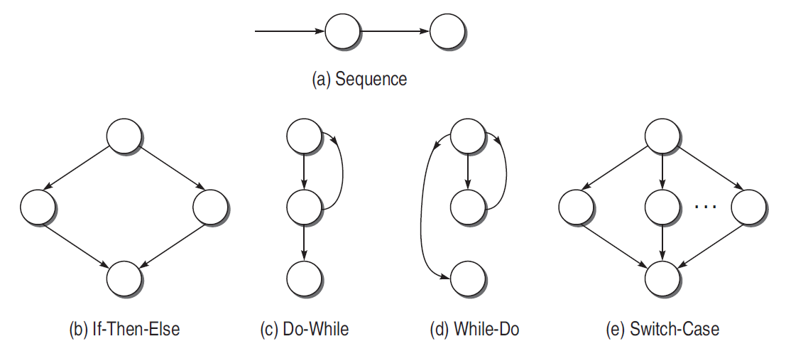
Flow Graph Notations

Slide 10
Independent Path
An independent path is any path through the graph that introduces at least one new set of processing statements or new conditions. An independent path must move along at least one edge that has not been traversed before the path is defined.

Slide 11
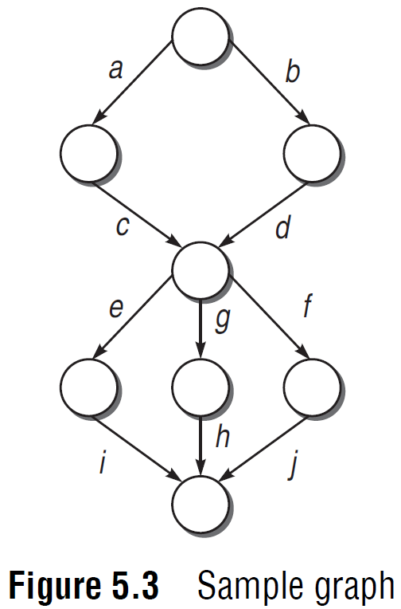
Cyclomatic Complexity
cyclomatic complexity,
V(G) = e – n + 2p
where p is the number of graphs and e and n are referred to as the whole graph,
V(G) = d + p
where d is the number of decision nodes in the graph.
V(G) = number of regions in the graph

Slide 12
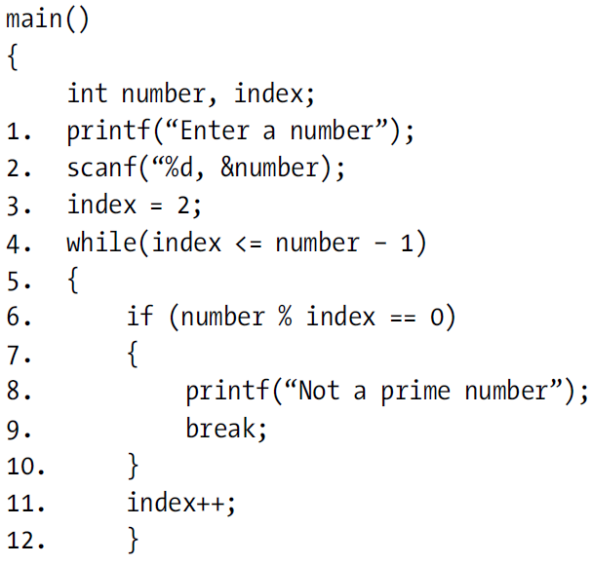
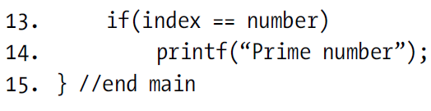
Example 5.1

Slide 13
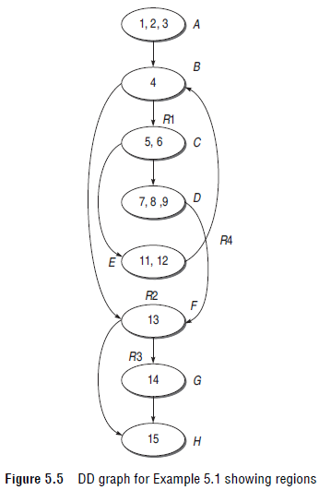
Example 5.1
Cyclomatic complexity
(V(G) = e – n + 2 * p
= 10 – 8 + 2
= 4
V(G ) = Number of predicate nodes + 1
= 3 (Nodes B, C, and F ) + 1
= 4
V (G ) = Number of regions
= 4(R1, R2, R3, R4)

Slide 14
Independent paths
(i) A-B-F-H
(ii) A-B-F-G-H
(iii) A-B-C-E-B-F-G-H
(iv) A-B-C-D-F-H

Slide 15
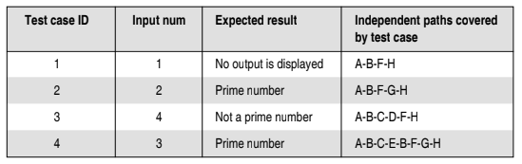
Test case design from the list of independent paths

